Slide 1
Lab: G-Correlate
Exploring a Data Analytics online education marketing campaign

Slide 2
Marketing Campaign: Data Analytics Online Education Program
The world is generating increasing amounts of data every year as we are finding more value from data
The number of individuals trained to extract value from this data is not nearly keeping up with the demand for this talent
We need:
More trained data scientists
smarter ways to extract value from data
This campaign to recruit students into a Data Analytics program seeks to address both needs

Slide 3

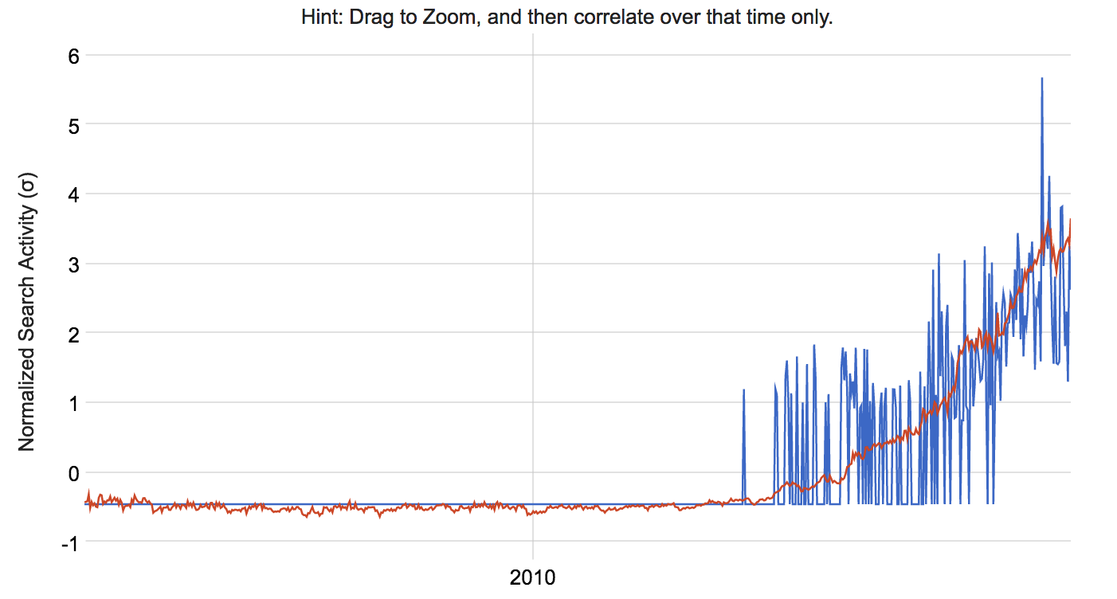



Time Series Analysis
There is an interest in the practice of data analytics rising consistently since around 2013.
This is represented in the graphic where we see an upward trend in the use of the terms data analytics driving a search.

Slide 4
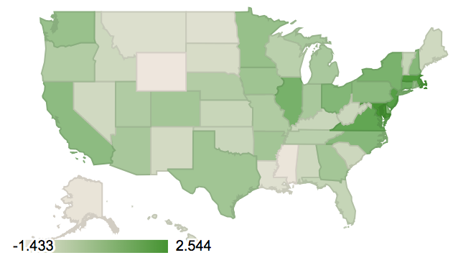
US State Comparison
State | Score
DC | 2.544
MD | 2.492
MA | 2.217
NJ | 1.933
VA | 1.589
CT | 1.39
IL | 1.065
NY | 0.995
Larger Metropolitan areas in the Northeast of the US demonstrate greater interest in data analytics if search results can be used as a means of measurement

Slide 5
Conclusion
A marketing campaign for an Online education program in Data Analytics has a reasonable likelihood of success as a result of:
High demand for data analysts/scientists
Inadequate supply of trained data analysts
Increasing interest in the field of Data Analytics
A marketing strategy should focus on metropolitan areas in the northeast of the United States as there is a disproportionate interest in this area.

